Slide 1


ML Geeks
Problem:
Customer’s eligibility for Home
loan.
Team Members:
Vinirmith Sai Krian
Chidvilas Geetanjali
Harsha Keerthi
Sravanthi
Mentors:
Adwait Pande
Ankur Sharma
This Photo by Unknown Author is licensed under CC BY-SA

Slide 2

Table of Contents
Introduction
EDA on dataset
Project Overview
Feature Engineering
Problem Statement
Initial findings
Proposed Solution
Evaluation metrics
Approach
Conclusion
Architectural Diagram

Slide 3
• Loans are the core business of banks.
• The main profit directly comes from the loan’s interest.
• Loans will be granted after an intensive process of verification
and validation.
• However, they still don’t have assurance if the applicant can
repay the loan with no difficulties.
• In this project we built a predictive model to predict if an applicant is eligible for the loan or not.
Project Overview

Slide 4
Intensive time Consumption process of verification and validation.
Human errors can be identified during the validation process.
No cross referencing previous loan records
Lot of human resource required.
Problem Statement
Proposed Solution:
Our Machine learning model calculates all the parameters given and predicts if the applicant is eligible for loan or not .
Time required for verification, and validation reduces significantly.

Slide 5









Architectural Diagram
EDA Process
Data Preprocessing
ML Model training
ML Model
re-training
Data Loading
Export Model
Model Evaluation
User
UI

Slide 6


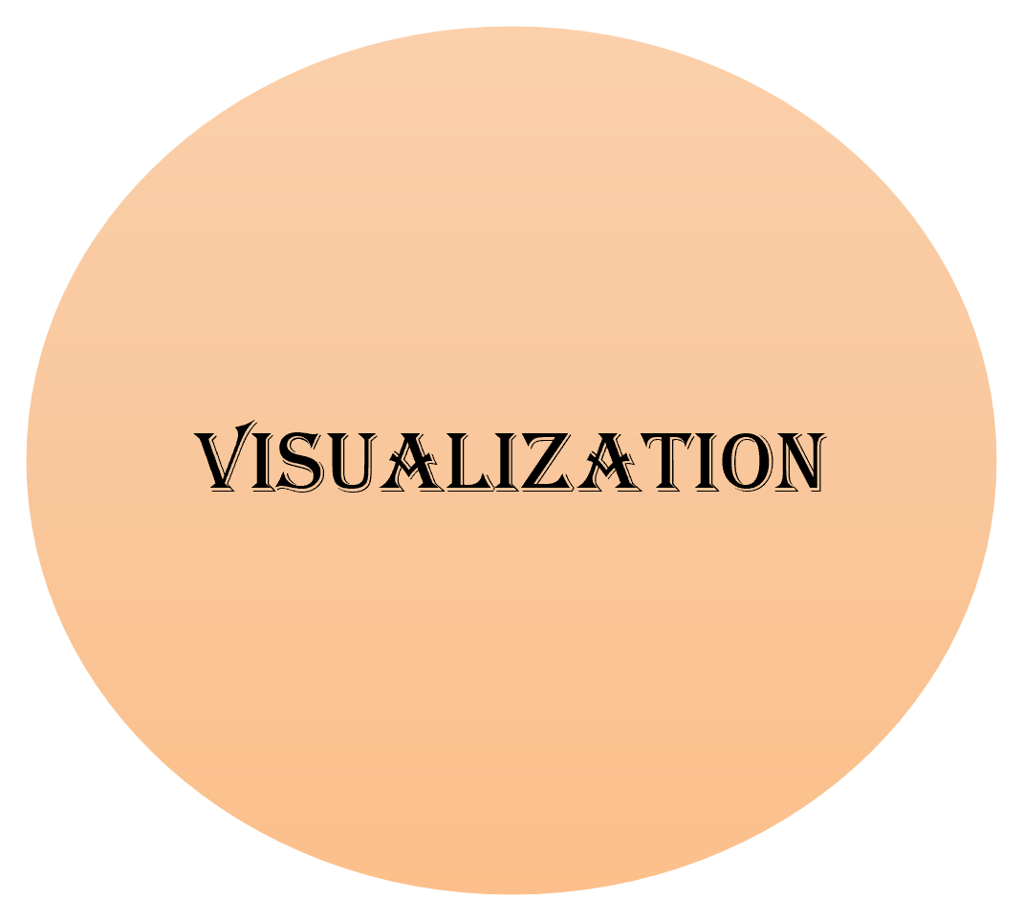
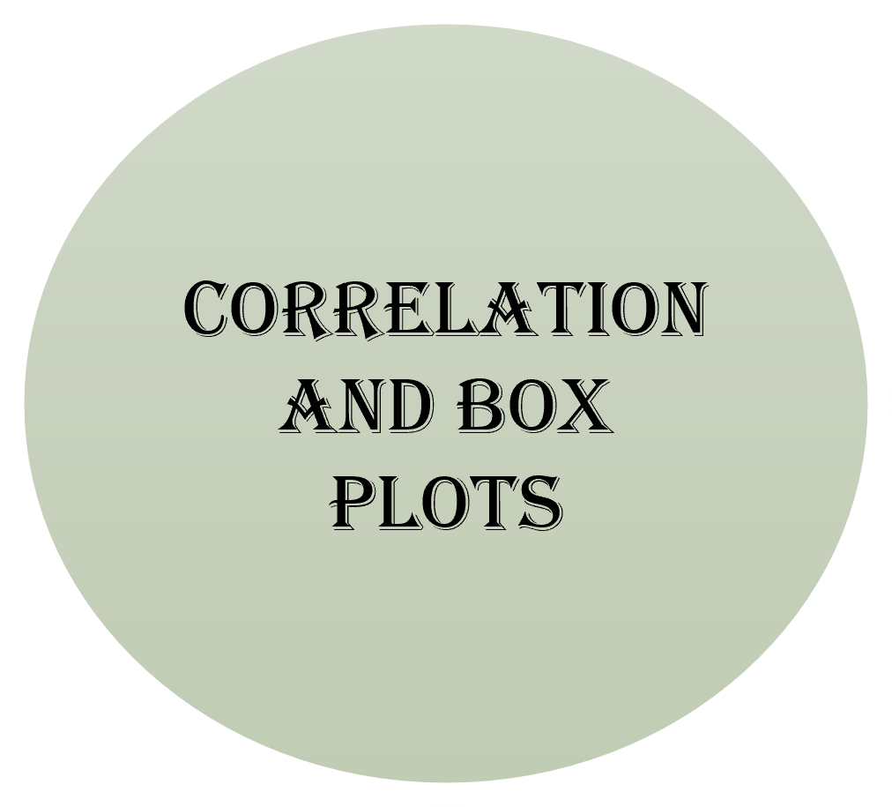

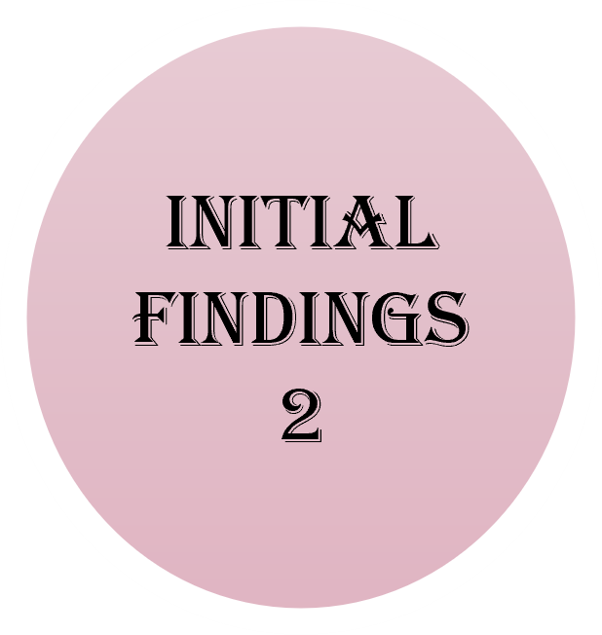

Slide 7
EDA on the dataset
Visualizing the key insights from the dataset.
Identifying the null values.
Analysing data skewness.
Detecting outliers.
Identifying Unnecessary Features.
Test underlying assumptions.

Slide 8
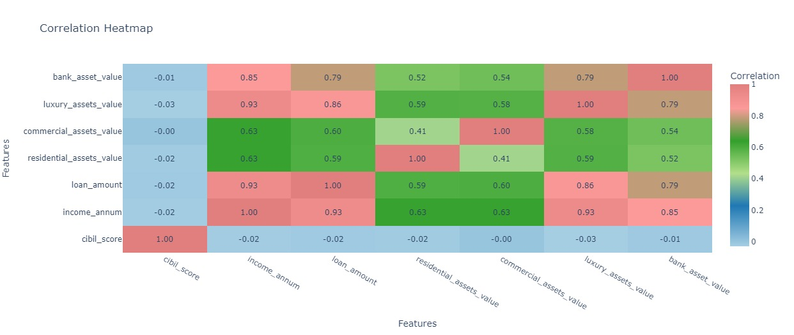
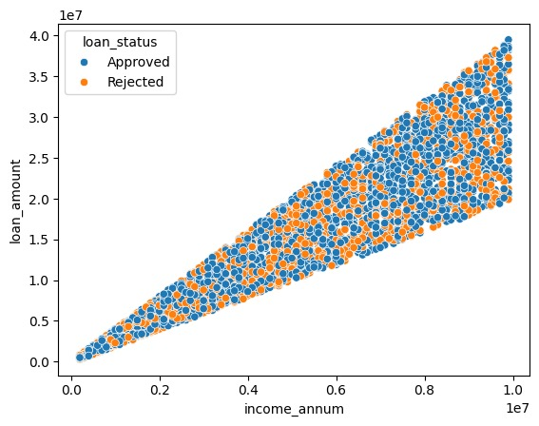
Visualization

Slide 9
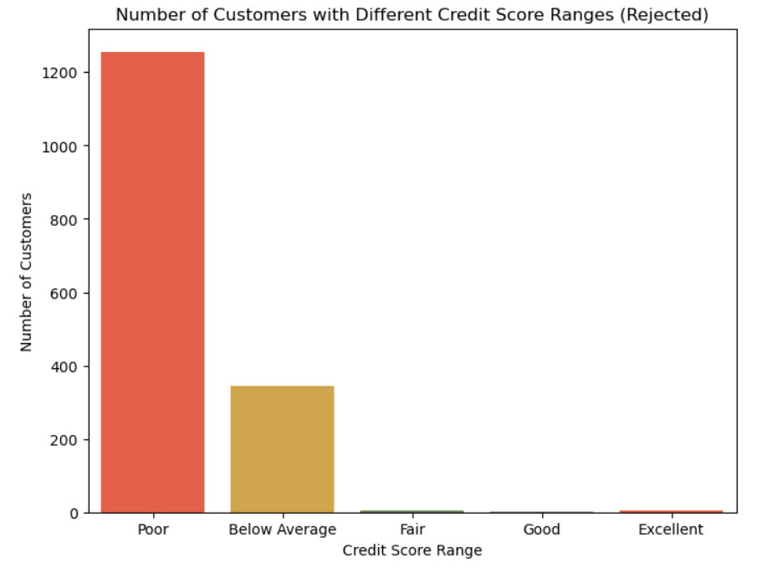
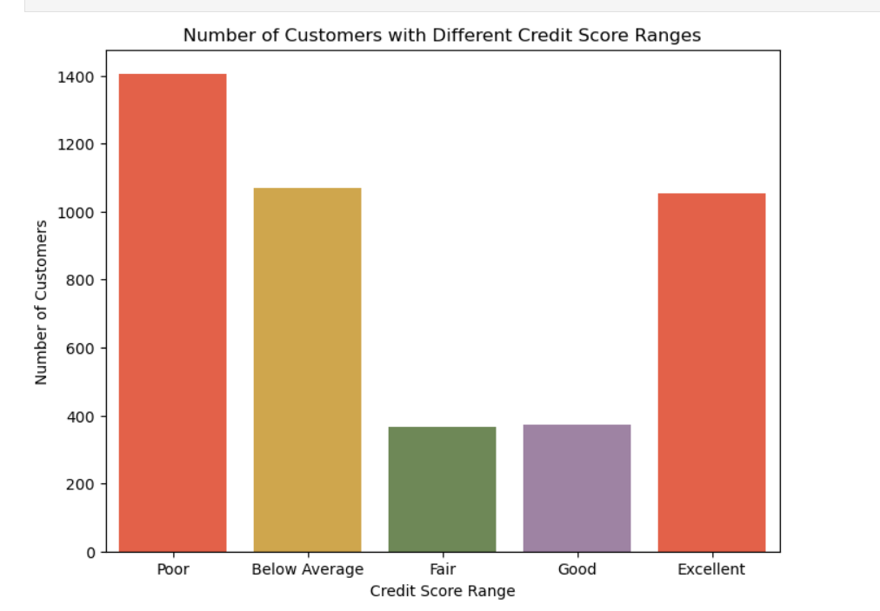
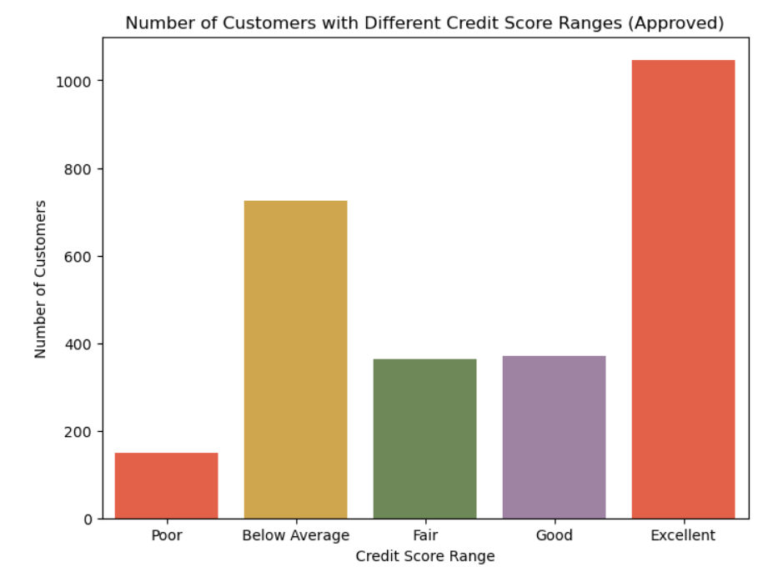
EDA on the Dataset

Slide 10
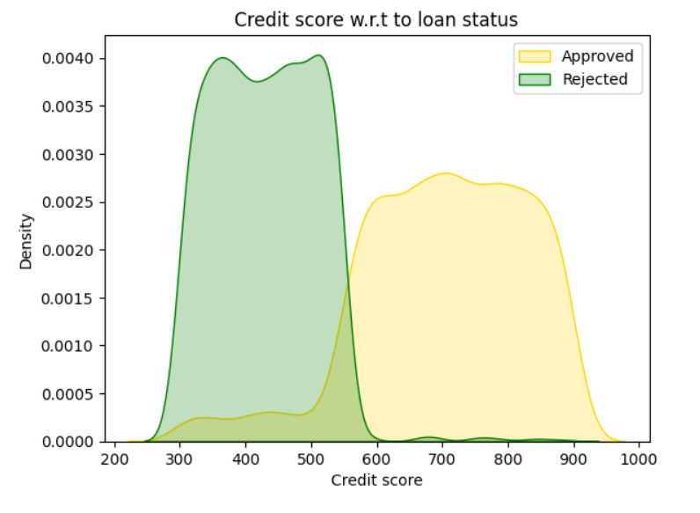
Initial Findings
Findings:
There are 11 people who got rejected with high Credit Score
There are 531 people who got accepted with low Credit Score

Slide 11
Initial Findings
Possible Reasons for Loan Acceptance with Low Credit Score:
Collateral or Assets: Providing valuable collateral or assets.
Stable Income: Demonstrating a stable and sufficient income.
Co-Signers or Guarantors: Having a co-signer with a higher credit score.
Possible Reasons for Loan Rejection with Higher Credit Score:
Insufficient Income: Income not sufficient to cover the loan.
Credit Report Details: Presence of negative items in the credit report.
Unstable Employment: History of unstable employment.
Loan Amount Requested: Requesting an unusually high loan amount.
Lender's Criteria: Specific policies and risk tolerance of the lender.
Additional Considerations:
Loan Purpose: Purpose of the loan may influence approval.
Credit Scoring Model: Different models may weigh factors differently.
Application Details: Accuracy and completeness of application information.

Slide 12
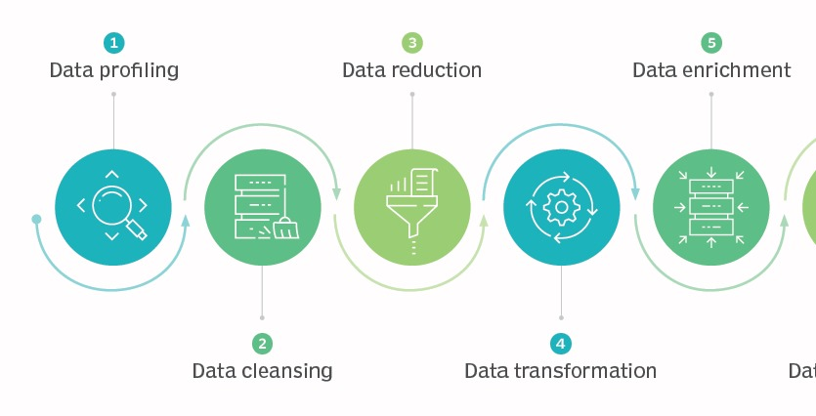
Data Preprocessing

Slide 13


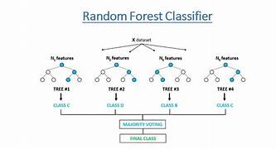
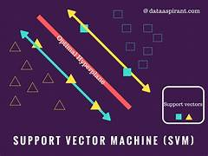

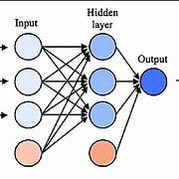

1) GaussianNB
2) Random Forest
Models Used
3) SVM Classifier
4) Decision Tree
5)XGBoost
6) ANN Classification

Slide 14

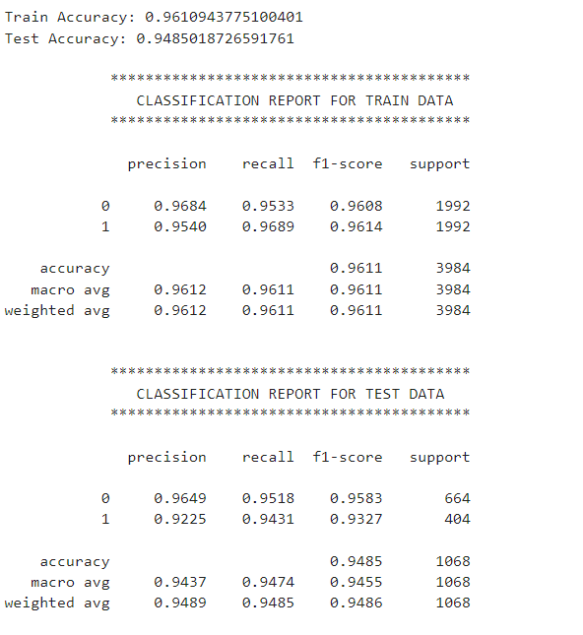
Evaluation Metrics
of Svm

Slide 15

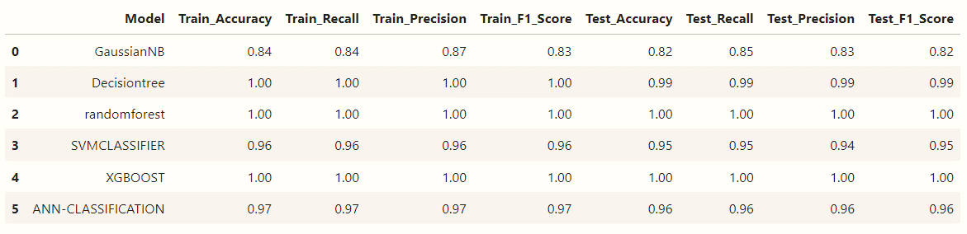

Slide 16


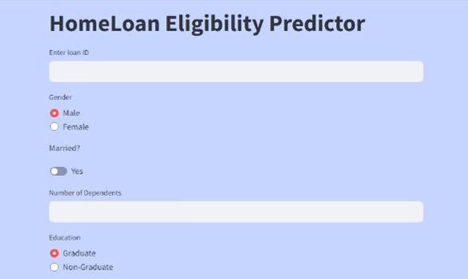
User Interface

Slide 17

From a proper analysis of positive points and constraints on the component, it can be safely concluded that the product is a highly efficient component.
This application is working properly and meeting to all Banker requirements.
This component can be easily plugged in many other systems.
Conclusion
ANN and SVM performed the best based on the evaluation Criteria.

Slide 18


